Slide 1








Timed Medicine Administration
Automated Pill Reminder and Dispensing System with Consumption Verification

Slide 2



Team Details
Name | Reg. No. | Department
Y. Bharath Kumar | 9922005075 | ECE
H. Dheeraj Kishore | 99220040269 | CSE
G. Narendra | 99220041481 | CSE
T. Akash Reddy | 99220040209 | CSE
T. Girish Swamy | 99220040207 | CSE

Slide 3


Agenda
Abstract
Key Components
Problem Statement
Block Diagram
Introduction
Pros n Cons
Objectives
Conclusion & Future Prospects
Proposed Solution
Industry Details
Literature Survey
References

Slide 4

Abstract
Timely and accurate medication intake is crucial for individuals with mental illness or disabilities. Challenges include forgetfulness, lack of adherence, and absence of verification, leading to missed doses. This work aims to address these issues by developing a system to ensure medication administration, improve adherence, and provide verification. The goal is to enhance patient safety and treatment effectiveness.
Timed Medicine Administration

Slide 5
Problem Statement
Designing a solution to ensure that prescribed medicines are taken on time by individuals with mental illness or disabilities presents significant challenges. These individuals often face difficulties such as drowsiness, unwillingness, or cognitive/physical impairments that hinder timely medication intake. A reliable system is needed that incorporates reminders, patient monitoring, and a mechanism to confirm medicine consumption, ensuring medication adherence and improving treatment outcomes.

Slide 6
Introduction
Ensuring timely medication intake is crucial for individuals with mental illness or disabilities.
Adherence challenges like forgetfulness and self-administering difficulties are common.
A solution is needed to guarantee medication administration and verification, especially in healthcare environments.
Challenges
Forgetting doses due to cognitive impairments.
Difficulty in self-administering medication without assistance.
Needs
A solution for timely reminders and accurate dosing.
A verification system for caregivers to monitor adherence.

Slide 7



Objectives
Intuitive and Accessible Design
The solution should be simple and easy to use for individuals with cognitive or physical impairments. It must ensure accessibility for all users.
Timely Alerts and Verification
Customizable Medication Schedules
The system should provide reminders and alerts for missed doses. It should also verify if the medicine has been taken.
The system should allow personalized medication schedules. This ensures timely reminders based on individual needs.

Slide 8
Literature Survey
S. No. | Title | Authors | Journal | Methodology | Research Gap
1 | Analysis of Internet of Things based Medication Dispenser Reminder and Drug Expiration Health Monitoring and its Applications (2024) | Raj, A. N., Kumar, G. S., Srinivasan, V., Reddy, D. L., Justin, B. V. F., & Priyadharshini, R. | 4th International Conference on Sustainable Expert Systems (ICSES) (pp. 241-244). IEEE. | The IoT-powered medicine box leverages Wi-Fi connectivity and the Blynk app for real-time communication, integrating health-monitoring sensors and frequent reminders to ensure timely medication intake while notifying caregivers via smartphones. | Current solutions lack integration of real-time caregiver notifications and seamless connectivity for remote health monitoring, limiting their effectiveness in addressing patient adherence and caregiver involvement.
2 | Automated pill dispenser to improve medication compliance, efficiency, and accuracy (2024) | Vaish, A. | IEEE World Forum on Public Safety Technology | The system incorporates an Arduino-based electronic control system and a custom Android application to program medication schedules, enabling precise pill dispensing from individual compartments, coupled with audio alarms for timely reminders. | Existing solutions lack affordable, portable, and reliable automated pill dispensers with real-time scheduling and dispensing, essential for independent users and public safety personnel in emergencies
3 | Smart Medication Management: Enhancing Medication Adherence with an IoT-Based Pill Dispenser and Smart Cup (2024) | Peddisetti, V., Kandregula, P. K., John, J. A., Poomdla, S., George, K., & Panangadan, A. | In 2024 IEEE First International Conference on Artificial Intelligence for Medicine, Health and Care | The solution employs IoT devices like the Arduino Nano RP2040-based Smart Pill Dispenser and Smart Cup with integrated sensors, connected via Bluetooth Low Energy, alongside an Android application for real-time notifications and medication adherence tracking. | Existing solutions lack precise integration of real-time consumption verification and notification systems, which are critical for ensuring accurate and timely medication intake for vulnerable populations.

Slide 9
Literature Survey
S. No. | Title | Authors | Journal | Methodology | Research Gap
4 | A Systematic Review on Pill and Medication Dispensers from a Human-Centered Perspective (2024) | Gargioni, L., Fogli, D., & Baroni, P. | Journal of Healthcare Informatics Research | The IoT-powered medicine box leverages Wi-Fi connectivity and the Blynk app for real-time communication, integrating health-monitoring sensors and frequent reminders to ensure timely medication intake while notifying caregivers via smartphones. | Existing studies lack comprehensive insights into user-centered design approaches and real-world implementation challenges for pill dispensers, limiting their usability and acceptance in healthcare
5 | A Smart Voice Assistant Based Hospital Companion with Medicine Dispenser (2023) | Harini, A., Thejasvi, S., Abinaya, V. U., & Sumathi, S. | Intelligent Computing and Control for Engineering and Business Systems | The system integrates IoT-based automated pill dispensing, a healthcare-specific voice assistant for interaction and mental support, and sensor-driven health monitoring to track vital parameters and emotion detection for stress management. | Existing solutions often lack comprehensive integration of real-time health monitoring, emotion-based stress interventions, and interactive assistance, which are critical for holistic healthcare management.
6 | IoTAAMD: Experimental Analysis of IoT Assisted Systematic Medicine Dispenser with Logical Sensors Association (2023) | Dheerthi, N., Kumar, A. K., Priyadharsheni, J. M., & Murugarajan, A. | International Conference on Innovative Computing, Intelligent Communication and Smart Electrical Systems | The Anytime Automatic Medicine Dispenser (AAMD) is an IoT-based system designed to dispense up to 10 prescriptions with real-time tracking of dosage schedules, alerting caregivers if the user misses a dose, ensuring medication availability 24/7. | Conventional medicine dispensers lack features like real-time dosage tracking, caregiver notifications, and support for multiple prescriptions, reducing their efficiency in healthcare

Slide 10
Literature Survey
S. No. | Title | Authors | Journal | Methodology | Research Gap
7 | Smart Medical Pills Dispenser (2023) | Alnajjar, K. A., Altamimi, A., Altamimi, K., Alshehhi, A., Ansari, S., Mahmoud, S., & Hussain, A. J. | 16th International Conference on Developments in eSystems Engineering | The proposed system leverages mobile phones for delivering timely medication reminders and incorporates a patient-to-hospital communication framework, enabling caregivers to schedule and monitor medications, dosages, and timings. | Existing solutions lack robust caregiver-controlled scheduling frameworks and seamless communication between patients and hospitals, limiting their effectiveness in ensuring medication adherence for chronic condition management.
8 | A Smart Medication Box with Regular Medications and In-Time Refilling (2023) | Praveena, H. D., & Geetha, P. | 2nd International Conference on Edge Computing and Applications | The Smart Medication Box utilizes LED displays, sound, and light for medication reminders, along with a GSM module to notify family members about medicine intake and manage medicine stock by automating refill requests through authenticated pharmacists. | Existing systems fail to integrate automated medicine stock monitoring and refill requests alongside real-time intake notifications, leaving gaps in comprehensive medication management for elderly individuals.

Slide 11


Proposed Solution &
Key Features
Reminder Mechanism
Medicine Dispensing
A buzzer and LED light up at the prescribed time, providing both auditory and visual cues to alert the patient, ensuring they do not miss their medication time.
The system's automated medicine box dispenses the exact dosage required, eliminating the risk of incorrect or missed doses and ensuring the patient receives the right medication at the right time.
Consumption Verification
Caregiver Notification
An ultrasonic sensor, attached to the patient's shirt, detects motion and verifies whether the patient has taken the medicine, ensuring accurate monitoring of adherence.
If the medicine is not consumed, a notification is immediately sent to the caregiver, allowing for quick intervention and ensuring the patient’s medication schedule is not disrupted.

Slide 12


Key Components
Hardware Requirements
Buzzer and LED System
Medicine Dispensing Box
Servo Motor
Ultrasonic Motion Sensor
Microcontroller
Medication Storage
Connectivity Module (e.g., Wi-Fi/Bluetooth)
Software Requirements
Motion Detection and Verification Software
Notification System Software
Control Software for Scheduling and Notifications
User Interface (UI) Software

Slide 13
Components & Budget
S. No. | Component Name | Price | Link
1 | Arduino Uno | 700/- | https://amzn.in/d/b7qtoPA
2 | Ultrasonic Sensor | 88/- | https://amzn.in/d/icLqaVo
3 | Servo Motor | 150/- | https://amzn.in/d/ez8b1Pr
4 | LCD | 239/- | https://amzn.in/d/bxCXS3R
5 | Buzzer | 49/- | https://amzn.in/d/ct6WSnq
6 | Bread Board | 99/- | https://amzn.in/d/3hWiPnq
7 | Push Buttons | 22/- | https://amzn.in/d/61MLev3
8 | Jumper Wires | 280/- | https://amzn.in/d/evYe2mL

Slide 14
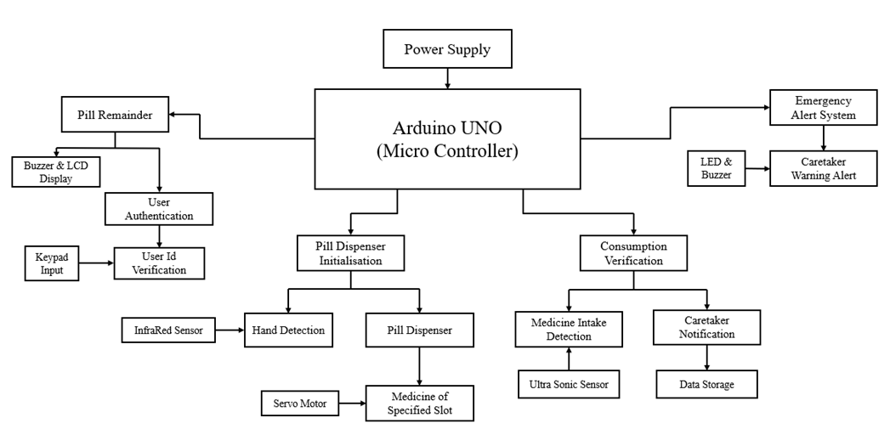
Block Diagram

Slide 15
Pros & Cons
Advantages
Improved Medication Adherence
Patient Monitoring
Reduced Human Error
Ease of Use
Caregiver Support
Customizable Schedules
Disadvantages
Dependence on Technology
Initial Setup Cost
Patient Resistance
Limited Scope for Complex Medication Regimens
Maintenance Requirements

Slide 16
Conclusion &
Future Prospects
Conclusion
The Automated Pill Reminder and Dispensing System ensures timely medication intake, improving adherence and reducing human error. It provides real-time monitoring and verification, enhancing support for patients with mental illness or disabilities. The system offers a reliable and efficient solution for improving patient outcomes in healthcare settings.
Future Prospects
This solution can be expanded to cater to complex medication regimens and different patient needs. Future improvements can include integrating advanced sensors and AI for better customization. The system also presents opportunities for commercialization and launching startups in the healthcare technology sector.

Slide 17




Industry Details
Available Domains
QUANTANICS TECHSERV PRIVATE LIMITED
AI & ML
Robotics & Automation
Block Chain
Big Data Analytics
Internet Of Things
Website & 3D Designing
Founded in 2018, Quantanics is a leading innovator in Industry 4.0, specializing in intelligent devices and solutions for major industrial giants and MNCs. With expertise across Blockchain, IoT, Robotics, AI, XR, and Big Data, the company has built a strong reputation for cutting-edge technology. Quantanics also develops industrial 3D modules and offers technical workshops for students, educators, and industry professionals across Tamil Nadu.
No.207/49 A, VOC Nagar,
North Street, PP Chavadi,
Madurai - 625016,India.
support@quantanics.in
9952725580

Slide 18
References
Peddisetti, V., Kandregula, P. K., John, J. A., Poomdla, S., George, K., & Panangadan, A. (2024, February). Smart Medication Management: Enhancing Medication Adherence with an IoT-Based Pill Dispenser and Smart Cup. In 2024 IEEE First International Conference on Artificial Intelligence for Medicine, Health and Care (AIMHC) (pp. 137-144). IEEE.
Harini, A., Thejasvi, S., Abinaya, V. U., & Sumathi, S. (2023, December). Curie–A Smart Voice Assistant Based Hospital Companion with Medicine Dispenser. In 2023 Intelligent Computing and Control for Engineering and Business Systems (ICCEBS) (pp. 01-05). IEEE.
Praveena, H. D., & Geetha, P. (2023, July). A Smart Medication Box with Regular Medications and In-Time Refilling. In 2023 2nd International Conference on Edge Computing and Applications (ICECAA) (pp. 1066-1070). IEEE.
Dheerthi, N., Kumar, A. K., Priyadharsheni, J. M., & Murugarajan, A. (2023, December). IoTAAMD: Experimental Analysis of IoT Assisted Systematic Medicine Dispenser with Logical Sensors Association. In 2023 International Conference on Innovative Computing, Intelligent Communication and Smart Electrical Systems (ICSES) (pp. 1-7). IEEE.

Slide 19
References
Vaish, A. (2024, May). Automated pill dispenser to improve medication compliance, efficiency, and accuracy. In 2024 IEEE World Forum on Public Safety Technology (WFPST) (pp. 192-196). IEEE.
Gargioni, L., Fogli, D., & Baroni, P. (2024). A Systematic Review on Pill and Medication Dispensers from a Human-Centered Perspective. Journal of Healthcare Informatics Research, 8(2), 244-285.
Alnajjar, K. A., Altamimi, A., Altamimi, K., Alshehhi, A., Ansari, S., Mahmoud, S., & Hussain, A. J. (2023, December). Smart Medical Pills Dispenser. In 2023 16th International Conference on Developments in eSystems Engineering (DeSE) (pp. 79-86). IEEE.
Raj, A. N., Kumar, G. S., Srinivasan, V., Reddy, D. L., Justin, B. V. F., & Priyadharshini, R. (2024, October). Analysis of Internet of Things based Medication Dispenser Reminder and Drug Expiration Health Monitoring and its Applications. In 2024 4th International Conference on Sustainable Expert Systems (ICSES) (pp. 241-244). IEEE.

Slide 20
Thank you for your attention

